Slide 1
ACADEMY OF EDUCATIONAL EXCELLENCE MAYO CLINIC COLLEGE OF MEDICINE AND SCIENCE
Lotte Dyrbye, MD, MHPE – Director, Academy of Educational Excellence
Heather Billings, PhD – Associate Director Faculty Development, MCCMS

Slide 2

What is the academy?
Check out our Mission, Goals, Director message, and FAQs
Why join the academy?
View the benefits of membership and current members
How do I join the academy?
Learn who can apply, what you should know before applying, and how to apply

Slide 3
MISSION
To inspire, develop, recognize, and support Mayo Clinic educators to better prepare learners to advance science, meet patients’ needs, and serve as transformative leaders

Slide 4
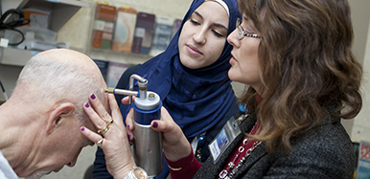
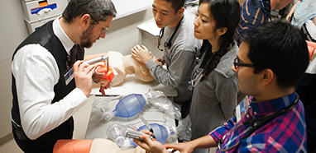
GOALS
Strengthen Education-Related Skills
Offer and coordinate a rich mosaic of faculty development resources across schools
Recognize Educators
Lapel pin
Mayo communications
Awards
Academic promotion
Build Community
Academy hosted events
Faculty Feed Newsletter
Who is involved in medical education
Notes:
Offer and coordinate a rich mosaic of faculty development resources across schools

Slide 5
FACULTY DEVELOPMENT ACADEMIES
Positively influence and engage faculty
Benefit recruitment
Advance the educational mission
Create a vibrant academic community
Develops teaching skills
Notes:
1. Benefit recruitment
2. Advance the educational mission of an academic medical center
3. Creates a vibrant academic community
4. Develops and promotes new teaching and learning skills
5. Positively influences faculty development in educational competencies

Slide 6
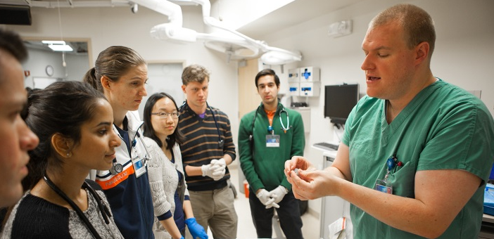
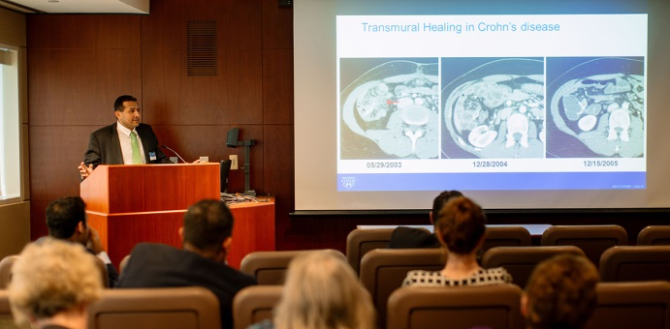
ACADEMY OF EDUCATIONAL EXCELLENCE
College-wide
Support development of all educators
Membership based on criterion-based standards
Not a replacement for academic rank
Not a database of recorded teaching hours

Slide 7
BENEFITS OF MEMBERSHIP
Receive recognition as an accomplished educator
Hone your academic skills through access to faculty resources
Advance your preparedness for academic promotion
Gain a competitiveness for education leadership roles
Attend Academy hosted events
Network within a community of educators
Notes:
Receive recognition for your endeavors as a highly accomplished educator
Hone you academic skills through access to the most timely and relevant faculty resources and development activities
Advance your preparedness for academic promotion and competitiveness for education leadership roles
Eligible for Academy distributed grants
Attend Academy hosted events
Network within a community of inter-professional educators

Slide 8
HOW TO APPLY
Anyone w. academic rank
Two criteria
Develop self as educator
Outcome
Teaching
Curriculum development
Educational leadership
Educational scholarship

Slide 9




CRITERION ONE IDENTIFY MEMBERSHIP LEVEL
LEGACY
80 hours or PhD in Education
SENIOR FELLOW
60 hours or Masters in Education
FELLOW
40 hours total
ASSOCIATE
20 hours within 5 years
Post college/graduate school faculty development
Notes:
Identifying a level is based on set number of faculty development sessions you have attended to advance your skills as an educator.
Legacy: Academy members have long standing active participation in the education shield or been national leaders in health professions and science education as demonstrated by leadership roles, education-related innovations and contributions to education scholarship
Senior Fellow: Academy members have demonstrated a sustained and consistent commitment to health professions and science education through participation, leadership and facilitation of professional development, and active mentorship of junior faculty.
Fellow: Academy members have a sustained commitment to health professions and science education and progressive participation in activities to improve their knowledge and skills as an educator and education scholar.
Associate: Academy members have an initial commitment to health professions and science education through participation in formal faculty development activities.

Slide 10
WHAT COUNTS TOWARDS MEMBERSHIP?
Your membership demonstrates your commitment as an educator, including
Time spent developing education skills in YOURSELF
Participating in courses, seminars, or similar activities to improve your skills as an educator
Time spent developing education skills of OTHERS
Presenting courses, seminars, or similar activities to advance the education skills of others

Slide 11
WHAT COUNTS TOWARDS MEMBERSHIP?
This does not include
Time spent learning medical or scientific related content and skills
Time spent teaching medical or scientific related content and skills to others
Mentoring learners
100% of the time spent at education meetings, such as the annual program directors meeting or ACGME/AAMC meetings

Slide 12
CRITERION TWO DEMONSTRATE EXCELLENCE IN ONE OF FOUR TRACKS
Excellence in …
TEACHING
CURRICULUM DESIGN AND ASSESSMENT
EDUCATIONAL ADMINISTRATION AND LEADERSHIP
EDUCATION RESEARCH AND DISSEMINATION
Notes:
Your membership in the Academy of Educational Excellence demonstrates your commitment as an educator. It is therefore important for you to document the time spent in education related academic career development.
This includes time spent developing education skills in yourself:
By participating in courses, seminars, or similar activities to improve your skills as an educator
AND time spent developing education skills of others:
By presenting courses, seminars, or similar activities to advance the education skills of others
By developing resources, tools, templates, rubrics, etc. to advance the education skills of others
This does not include:
Time spent learning medical or scientific related content and skills
Time spent teaching medical or scientific related content and skills to others

Slide 13
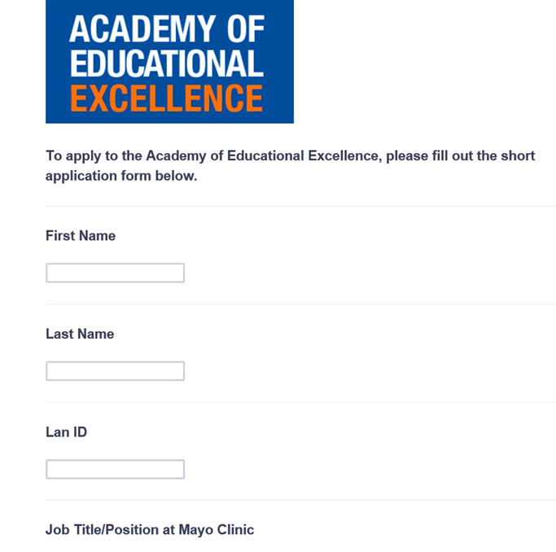
HOW DO I APPLY?
Fill out the application form
A designee may upload the information
Two options for listing information
Applications are accepted anytime – membership awarded quarterly

Slide 14
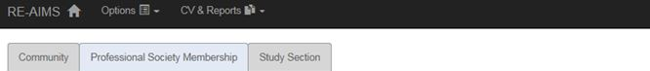
OPTION ONE DOCUMENTING FACULTY DEVELOPMENT
Update RE-AIMS
“Relating to teaching/education”
Academic career development
Publications/presentations
Professional society, committee roles

Slide 15
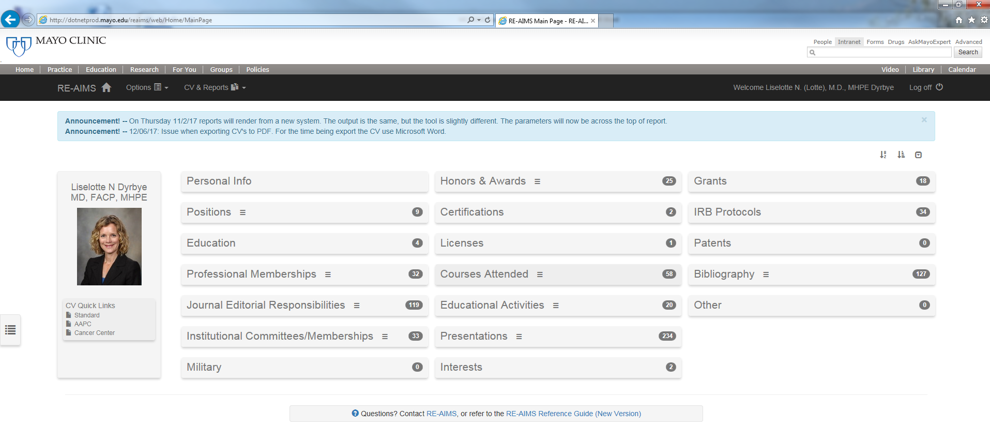
OPTION ONE DOCUMENTING FACULTY DEVELOPMENT

Slide 16
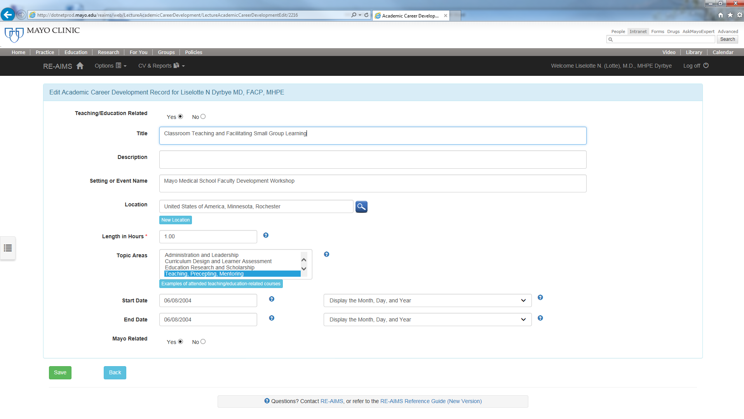
OPTION ONE DOCUMENTING FACULTY DEVELOPMENT

Slide 17
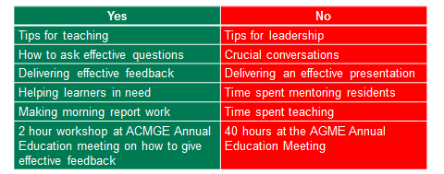
Development topics that Count and Do not Count

Slide 18
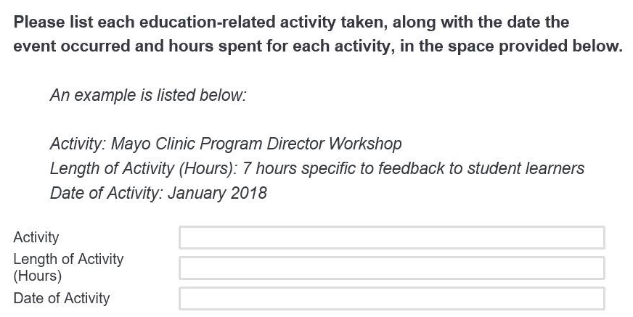
OPTION TWO APPLICATION PROCESS
List courses individually

Slide 19
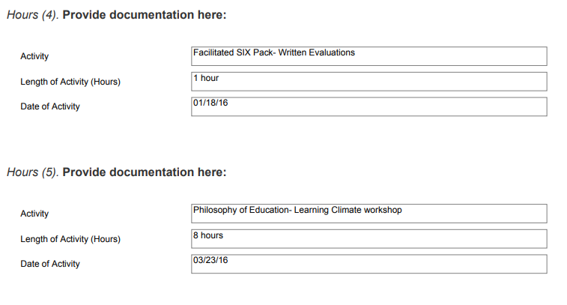
OPTION TWO EXAMPLES

Slide 20
OPTION THREE- Provide a Narrative APPLICATION PROCESS
If you have been teaching/educating in a professional role for > 15 years, you may provide a written narrative, in lieu of an itemized list of experiences, describing how you have developed yourself for this role.
All members of the Academy are asked to document hours through REAIMS in order to apply for progressive levels of membership or alternative tracks.

Slide 21
OPTION THREE WRITTEN NARRATIVE EXAMPLE
Your narrative should include:
How many years you have been a medical educator
Specific hours and workshops you have attended to better your skills as an educator
How you are demonstrating or utilizing these developed education skills in your career
This should not include time spent teaching medical or scientific content and skills to others, mentoring learners, or attending medical education meetings.
Notes:
As a professional educator for over 15 years, I have been actively involved in teaching, presenting, developing faculty, mentoring, visioning, creating educational programs, and conducting educational research. I have continued to explore new ways of learning and engaging in my own education skill development by attending a variety of faculty development workshops and events each year. To demonstrate my commitment to my own scholarly teaching, learning, assessment and education research skills, I have highlighted some key workshops and events that I participated in and continue to use these developed skills in my courses. These workshops include, but are not limited to:
The Enhancing Learning in Medicine (ELM) session (6 hours) where I learned how to promote an optimal learning climate and create resources that include my expectations, goals, and objectives when working with my learners in the classroom.
Education Technology Forum (12 hours, attended 2017,2018,2019, 2020) where I learned how to utilize education technologies in my classroom and engage my learners with active learning strategies
ACGME Education Conference Workshop (4 hours)
Workshop: Learning to be a better Mentor and Teacher in #MedEd
Faculty Development Lunch and Learns (1 hour each) on topics such as:
Tips for Effective Teaching
Delivering Feedback to learners in a timely manner
Prickly Parts of Feedback
Diagnosing the Learner
Improving Learner Engagement
I have attended these workshops and have found them to be beneficial for me in my role as a medical educator because it has helped me to develop skills to improve my teaching skills and apply education models in my classroom, such as the Kern’s and Wiggins models. I also have regularly attended Education Grand Rounds presentations and workshops and department faculty development retreats that are specific to improving my education research methodologies and skills. These cumulatively make up an additional 20 hours of education skill development over the course of my career at Mayo Clinic. I consider myself to be a life-long learner and thus why I believe I meet both criteria 1 and 2 for Fellow membership within the Academy of Educational Excellence.

Slide 22
CRITERION TWO DEMONSTRATE EXCELLENCE IN ONE OF FOUR TRACKS
Excellence in …
TEACHING
CURRICULUM DESIGN AND ASSESSMENT
EDUCATIONAL ADMINISTRATION AND LEADERSHIP
EDUCATION RESEARCH AND DISSEMINATION
Notes:
Your membership in the Academy of Educational Excellence demonstrates your commitment as an educator. It is therefore important for you to document the time spent in education related academic career development.
This includes time spent developing education skills in yourself:
By participating in courses, seminars, or similar activities to improve your skills as an educator
AND time spent developing education skills of others:
By presenting courses, seminars, or similar activities to advance the education skills of others
By developing resources, tools, templates, rubrics, etc. to advance the education skills of others
This does not include:
Time spent learning medical or scientific related content and skills
Time spent teaching medical or scientific related content and skills to others

Slide 23
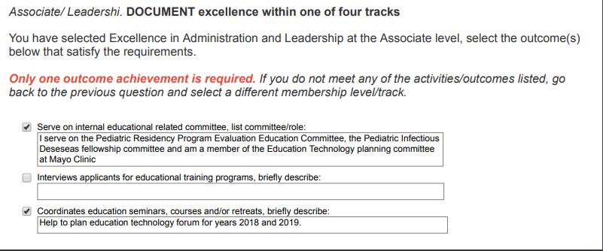
CRITERIA TWO EXAMPLE

Slide 24

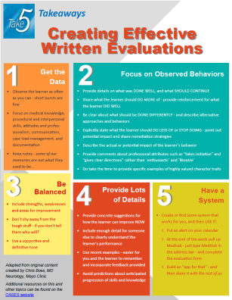
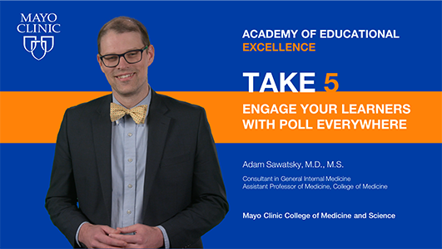
RESOURCES FOR EDUCATORS
Deliver seminars to advance colleagues’ educational skills
Take 5 Videos and Faculty Feed Newsletter
Faculty Development Calendar
SIX-Packs
Takeaways
Take 5 Videos

Slide 25
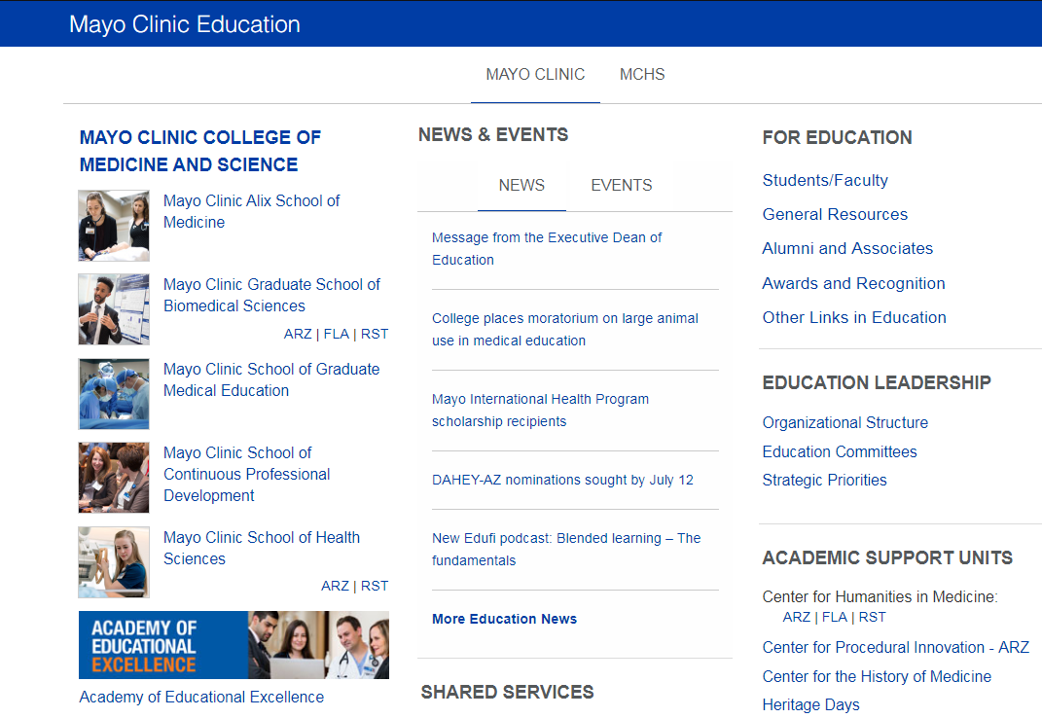

MAYO CLINIC EDUCATION
Academy of Educational Excellence
What is the academy?
Check out our Mission, Goals, Director message, and FAQs.
Why join the academy?
View the benefits of membership and current members.
How do I join the academy?
Learn who can apply, what you should know before applying, and how to apply.

Slide 26
FOLLOW US @MayoFacDev

